Slide 1
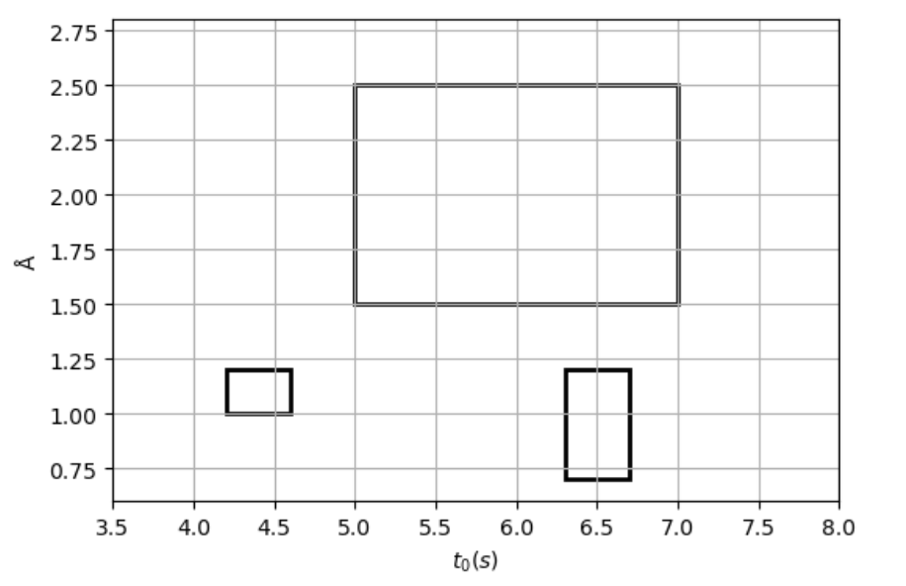
Igneous rock
Fullerene
Pollen

